Slide 1
What Should I Do Now?
IST 440W - Capstone Project
Christian Munoz, Elliot Parker, Sean Gold

Slide 2


Have You Ever..
Gotten bored, didn’t know how to spend your time? We get it - we have an easy answer!
Felt frustration when you didn’t know how to spend your time? We have all been there before too.
Had negative thoughts fill your mind due to not being occupied? Wouldn’t it be great to find an activity to do within seconds?

Slide 3
Why is it important to be occupied?
Loss of motivation & interest.
Frustration.
Depression.
Stress.
Luckily,
We found a way to help find something to do within seconds.

Slide 4
Our solution provides an INSTANT ACTIVITY that anyone can do in order to to combat boredom!
Defeat being unoccupied with:
An instant solution based on your own input
Many different activity ideas to do based on your mood
Fun, engaging, time consuming, and productive activities
Resources to seek professional help if your boredom contributes to negative mental health

Slide 5
How “What Should I Do Now” Works
It uses decision trees to find an activity that best suits your mood This gets you results that you are likely to explore
It shows you specific examples based on your results We provide exact answers to aid boredom
It gives you insight based on the result We describe what the activity involves before you explore it so you can get a glimpse first
It provides mental health resources if necessary Professional help is out of our scope - but we can still direct you towards where to find it

Slide 6
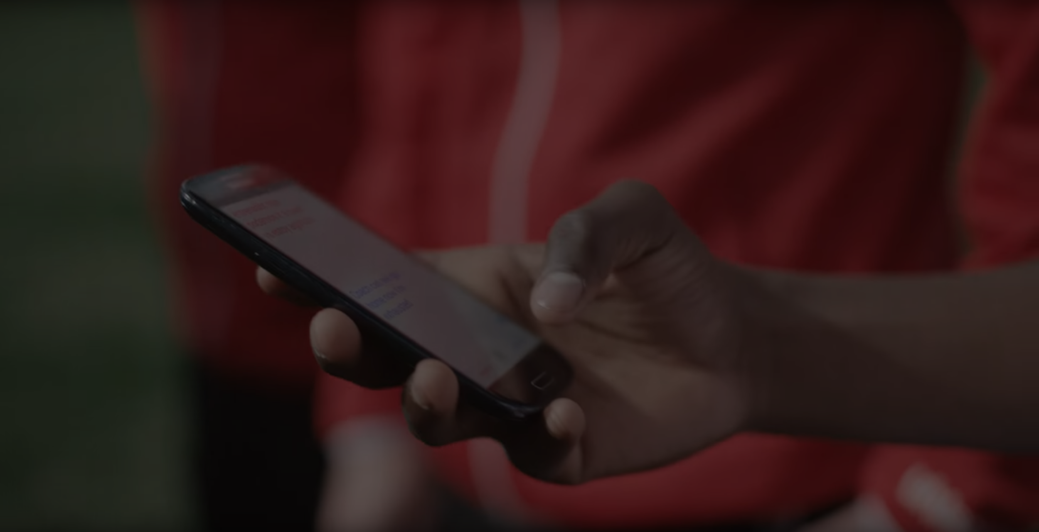
Finding a solution is important because it is medically proven that boredom contributes to seriously negative mental health
“Proneness to boredom is also associated with anxiety, impulsiveness, hopelessness, loneliness, gambling, and depression”
Zachary Jason, Harvard School of Education
“Boredom proneness is positively correlated with depression and anxiety”
Andreas Elpidorou, Frontiers in Psychology
“Boredom and depression are linked, and boredom can become destructive over time if it’s not positively addressed”
Stephanie Kirby, Better Help Counseling

Slide 7
Why is this important? Can’t I just search for something to do on Google?

Slide 8

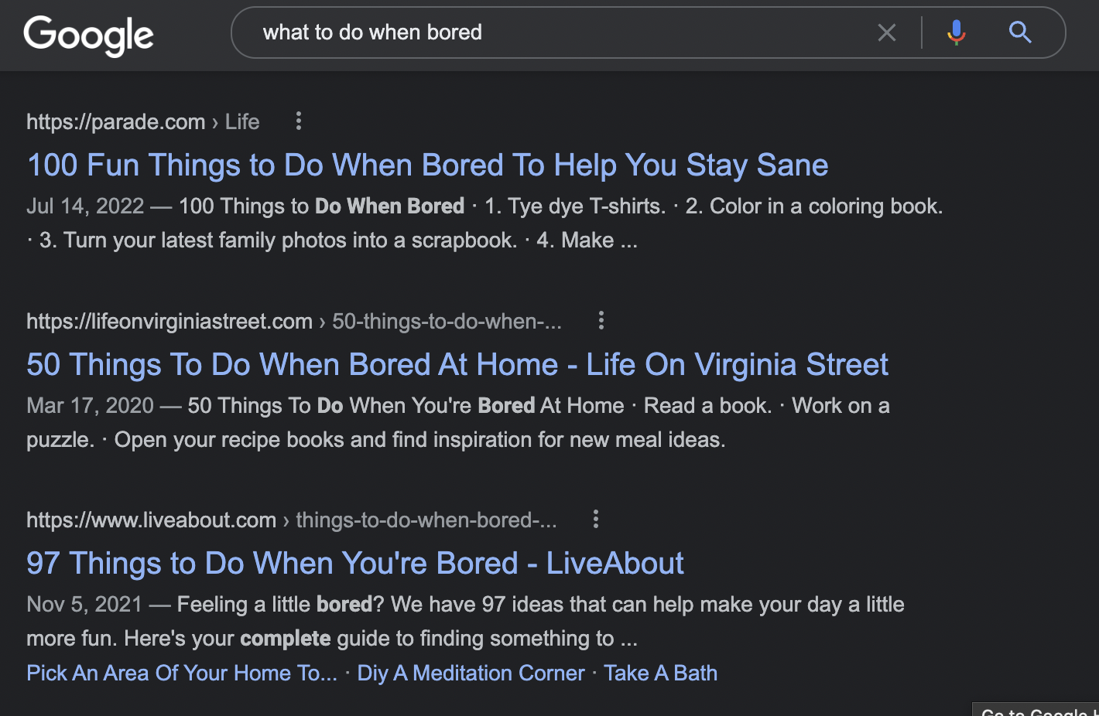
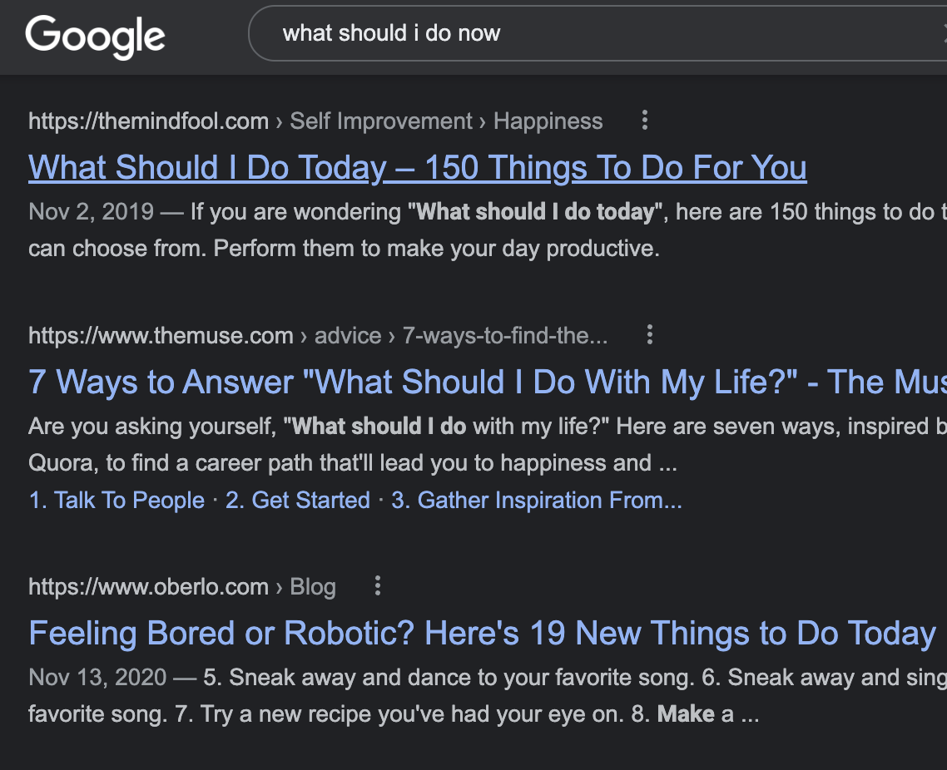
It is hard to find conclusive, input based results from a Google search. Google just generates articles with random lists.

Slide 9
We are clearly different. Here is an example of how “What Should I Do Now” can combat boredom

Slide 10

This is what happens when you do a Google search - no conclusive results!
https://drive.google.com/file/d/19NLaqFkl_b0xi0EW9BzI8CNQrlXXn_Cm/view?resourcekey

Slide 11
0=
This is what happens when you use “What Should I Do Now” - insight, examples, and help if needed!
https://drive.google.com/file/d/1Mac1R5T3WAXzjgVDhuqTp2xI5u81Tquu/view?resourcekey

Slide 12
Why We Switched To Wix
Better For Group Collaboration Our team members that do not code can make meaningful contributions.
Better For Security After the extensive testing, we decided to switch to Wix to take advantage of 2FA
Better For Accessibility Any team member can update changes on the portal within seconds
Static VS Dynamic Static is better for our purposes due to compatibility, ease of maintenance for all members, and security

Slide 13
What happens when we run into potential issues with the site?
Wix’s fault? Our fault?
Our security is outsourced to Wix. Any issue with it would be on them.
If Wix is down, we are down too
We can update any maintenance issues in a moment’s notice due to using the Wix portal
Very in depth testing is done with maintenance to avoid error pages, etc, due to the site’s static nature

Slide 14
Why Is This Site Important?
For Those With Mental Health Issues
To Avoid Sadness
You Can Find Something You Enjoy
You Can Discover A New Hobby
You need to do something engaging.
We Direct Them To Help.
For Mental Health |  |  |  | For Anyone
Literally, within seconds.
The end result can be rewarding - try out something new!

Slide 15
Future Outlook?
We hope to expand this platform even more.
Migrate to a fully dynamic, interactive user experience Eventually, we would like to migrate to a fully dynamic website
Generate income from ads We would like to get ad revenue to pay our developers
More possibilities, better tailored With a bigger developer team, we will make the experience more interactive, with more input driven results
Have a mobile version available We will be on iOS and Android devices as well

Slide 16
Conclusion
Our product helps everyone find a way to kill boredom.
Boredom is bad for health!
You can effectively get an engaging result in seconds!
Do something you like!
We are not a medical/mental health service, but we can help.
We direct you to find help.

Slide 17
Thank you!
We appreciate your attendance.
Christian Munoz, Elliot Parker, Sean Gold
clm6228@psu.edu emp5626@psu.edu ssg23@psu.edu

